Slide 1
Setting Up Clover through HN MyClub
Herbalife Nutrition

Slide 2
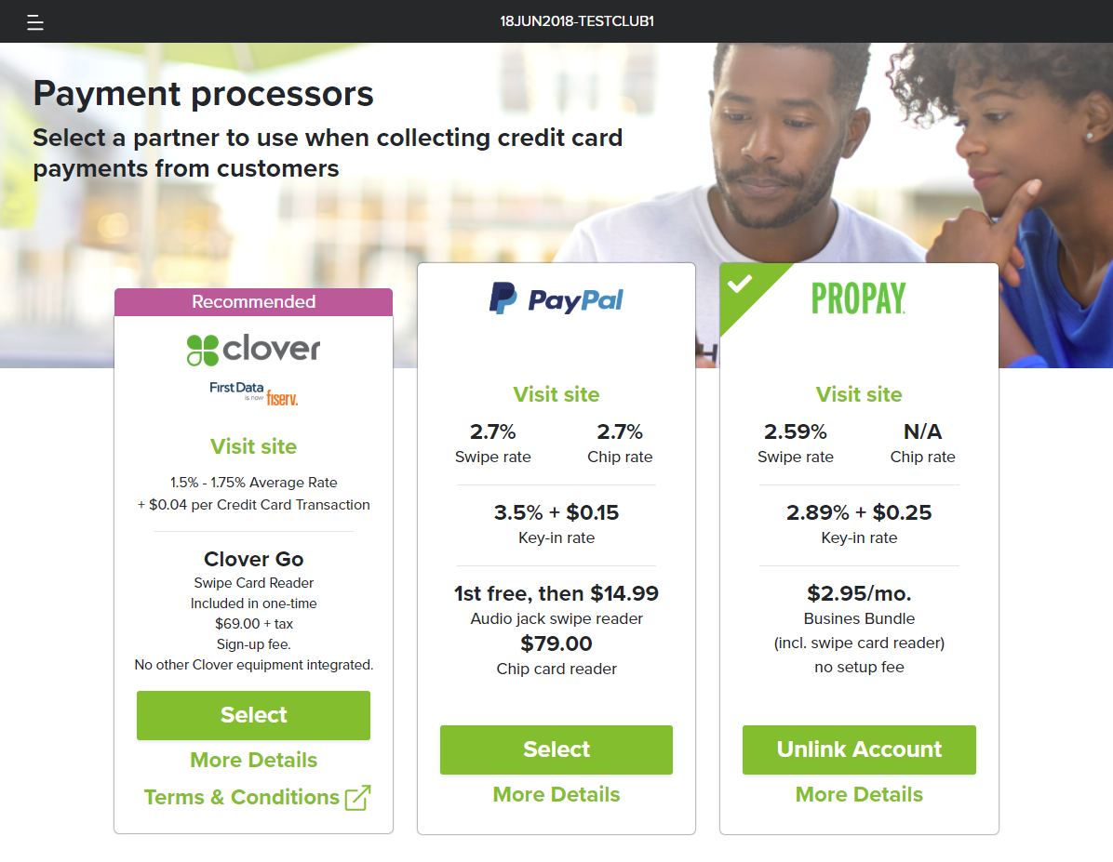
Clover Setup
To use Clover as your payment processor go to Settings → Payment Processors and click on “Select” inside the Clover box
These rates are only available through Herbalife Nutrition’s partnership with Clover, so you must sign up through HN MyClub. Do not sign up by going to Clover.com.
If you already have a Clover account, you will have to sign up for a new account here
In order for secondary operators to sign up for Clover, you need to make sure they have Edit available payment option enabled in Settings → Permissions → Cash Register

Slide 3
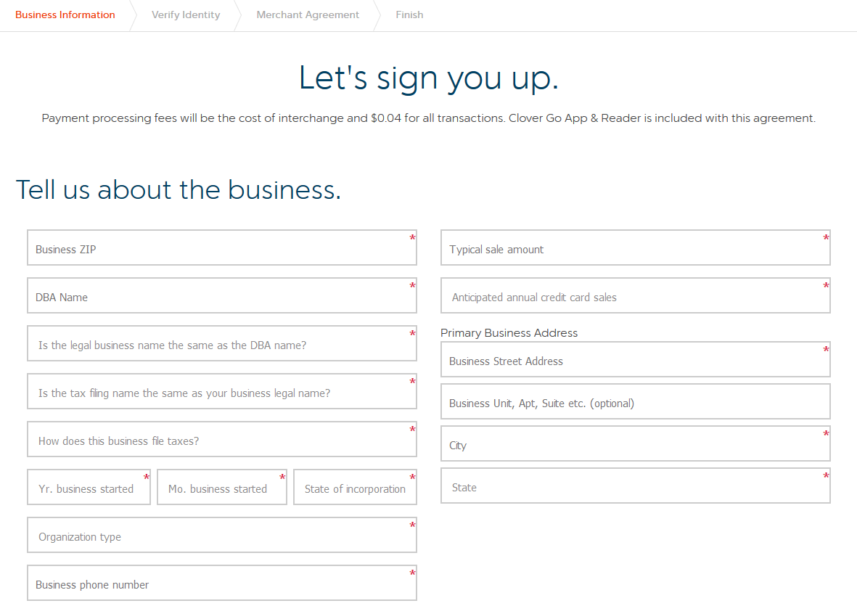
Clover – Business Information
You will be redirected to Clover’s sign-up form where you will need to enter your business information
Notes:
DBA (“Doing Business As”) Name – Please put the name of your Nutrition Club here. If you plan on using your Clover account for multiple Clubs, you can also use your personal name or corporation name if your Herbalife Nutrition Independent Distributorship is incorporated.
Primary Business Address – There is a 24-character limit for the addresses, so please use abbreviations where appropriate (e.g., St.,. Dr., etc.). If you have a unit, suite or apartment number, just put the number in the box.

Slide 4
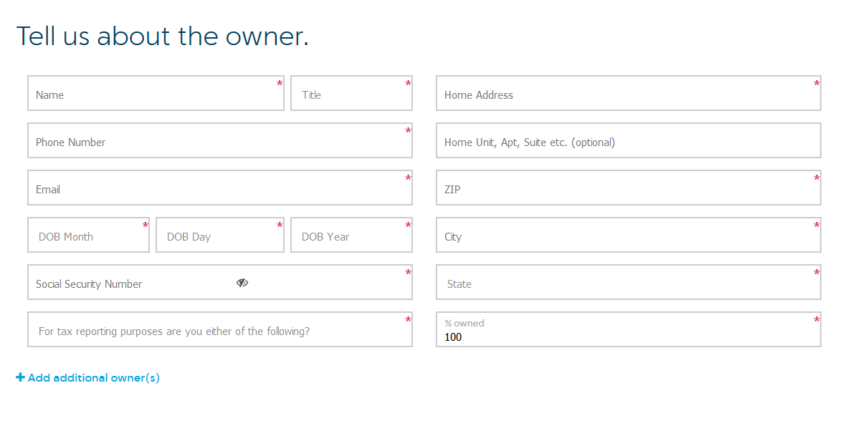
Clover – Owner Information
Now, enter the owner information
Notes:
Home Address - There is a 24-character limit for the addresses, so please use abbreviations where appropriate (e.g., St., Dr., etc.). If you have a unit, suite or apartment number, just put the number in the box.

Slide 5
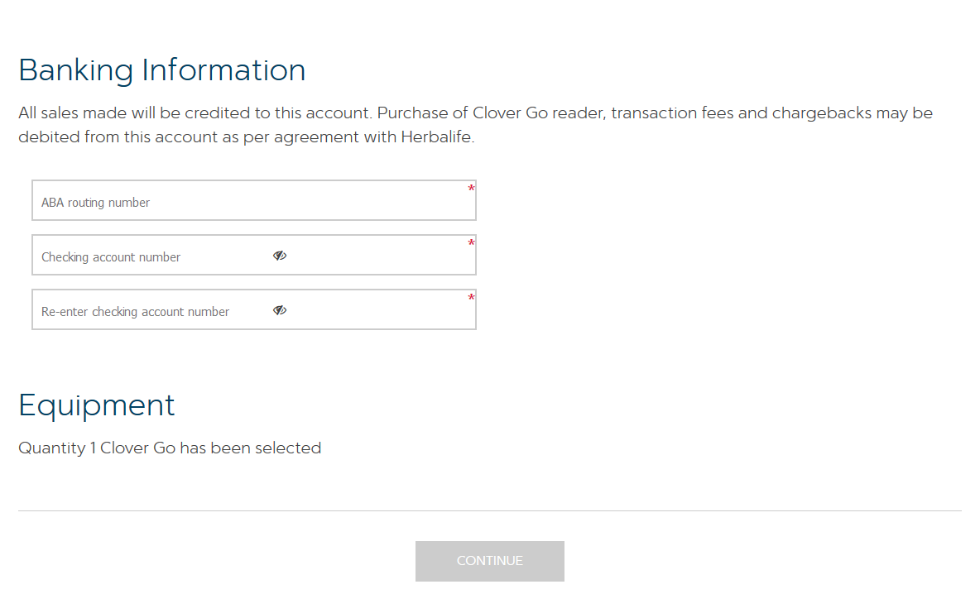
Clover – Banking Information
Then, enter your banking information
Equipment
Clover Go is the credit card reader you will be getting to process credit card transactions
It will be automatically sent to you within 3-5 business days
You will not need any additional Clover hardware to use Clover with HN MyClub
Now, click Continue

Slide 6
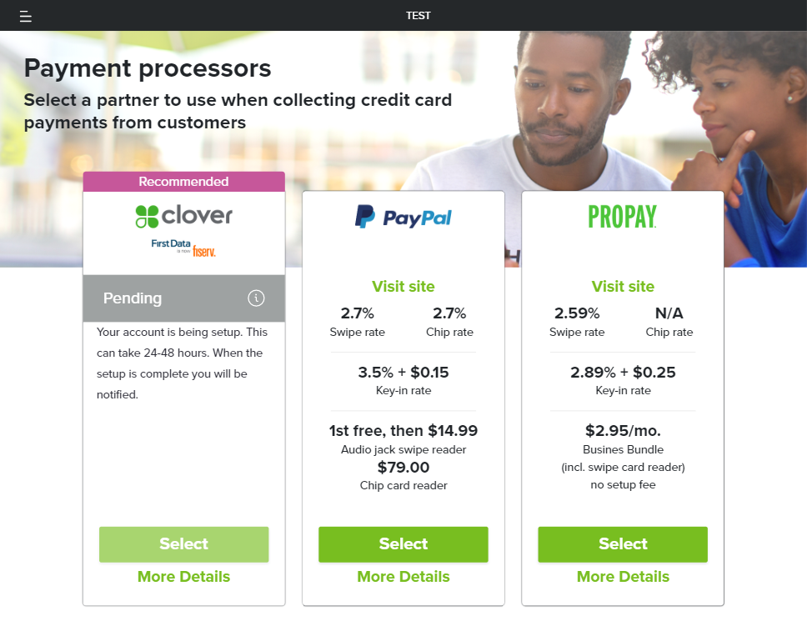
Clover – Account Pending
You will be redirected back to HN MyClub, and you will see your account status as Pending
Please allow up to 48 hours for your account to be ready to use
You will receive an email from Clover/Fiserv notifying you that your account is ready
If your account is pending for more than 48 hours, you will receive a letter in the mail requesting further information for approval

Slide 7
Return to this slide after you receive an email from Clover/Fiserv notifying your application has been approved.

Slide 8
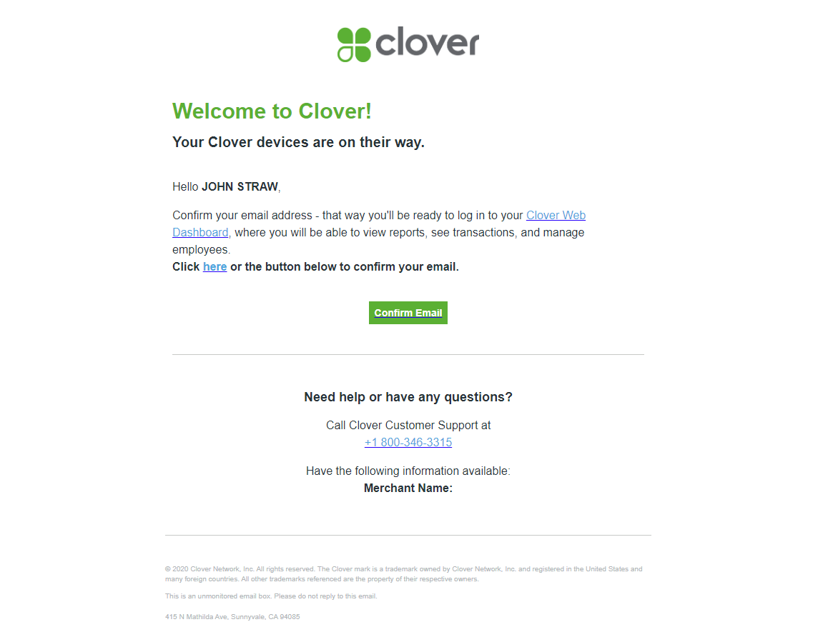
Clover – Clover Email
Once you receive the email from Clover/Fiserv notifying your account has been approved, please follow the instructions to confirm your email and create an account login
You can skip through the additional steps in the process asking to buy extra equipment or upgrade your account type, as they are not relevant for using Clover with HN MyClub

Slide 9
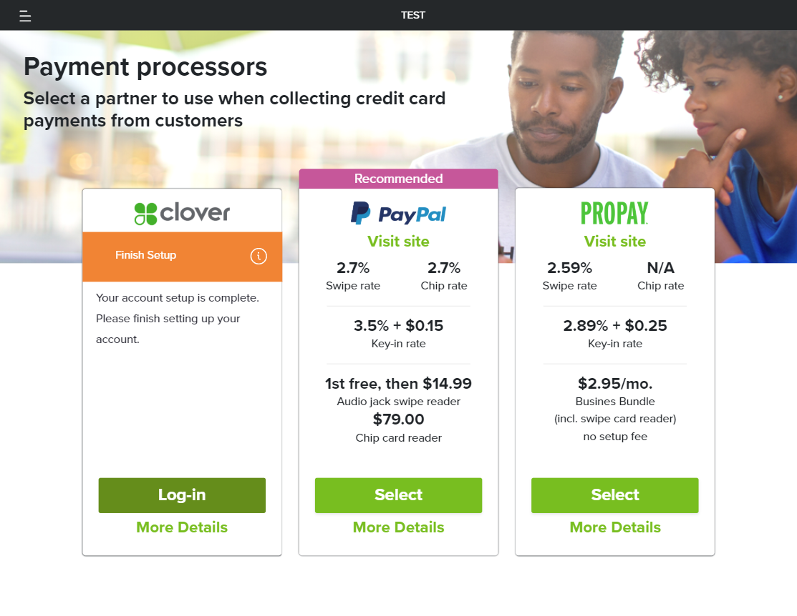
Clover – Finish Setup
After you’ve confirmed your email and created your login, please return to HN MyClub, and go to Settings → Payment Processors and click on Log-in to complete the setup process

Slide 10
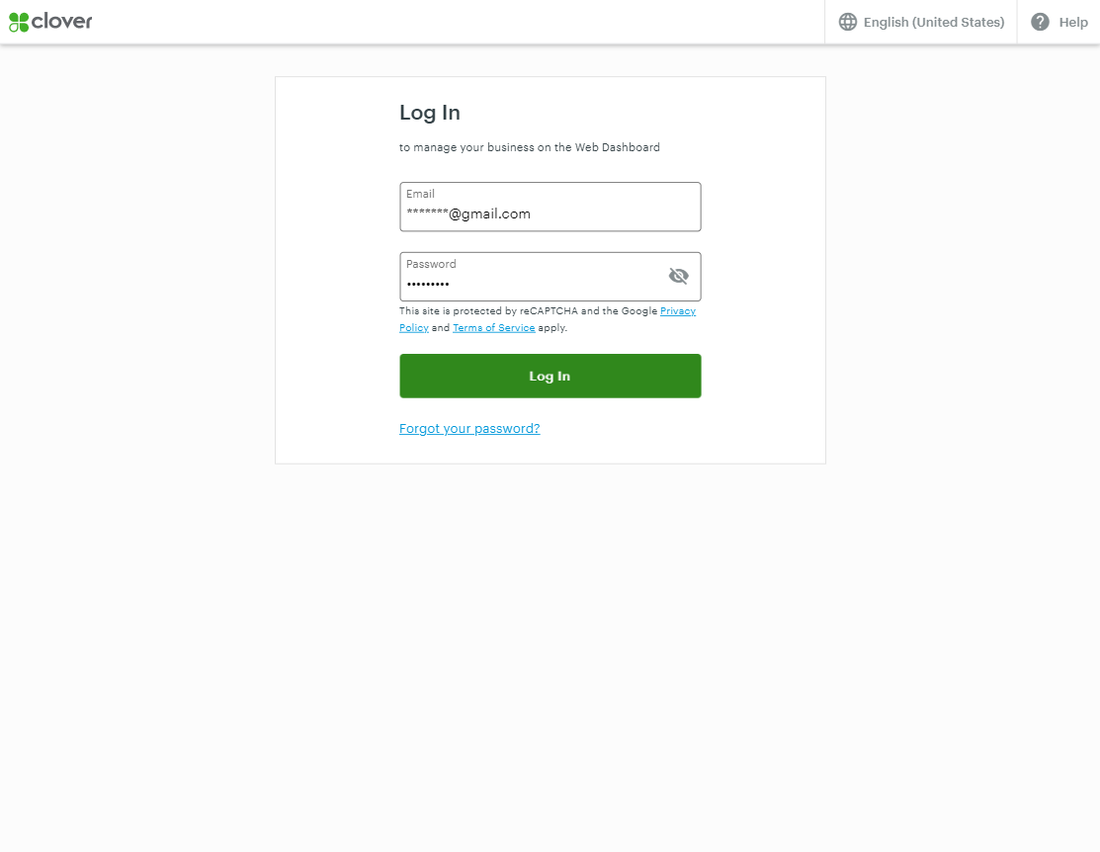
Clover – Log into Clover
You will be redirected to Clover’s login page
Use your new login to link your Clover account to HN MyClub

Slide 11
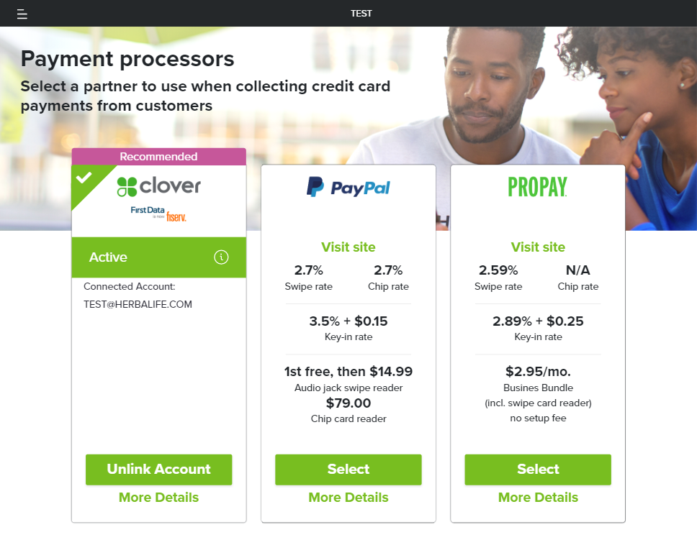
Clover – Account Active
You will be redirected back to HN MyClub, where you can verify your setup and linking are complete
If you see the word “Active” inside the Clover box, you are ready to process transactions

Slide 12
Clover – Account Active (Conditionally approved)
In two circumstances your account may be conditionally approved, which means Clover will hold your funds for 5–7 business days for the first 45 days.
Your account can be validated sooner based on the following:
Credit risk – Accounts that were conditionally approved based on credit risk will be validated after ten transactions and at least $1,000 in transactions.
Sign-up form input errors – Accounts that were conditionally approved based on an input error during sign up will be validated once Clover/Fiserv receives updated information. In this case you will receive an email from Clover/Fiserv requesting the necessary information.

Slide 13
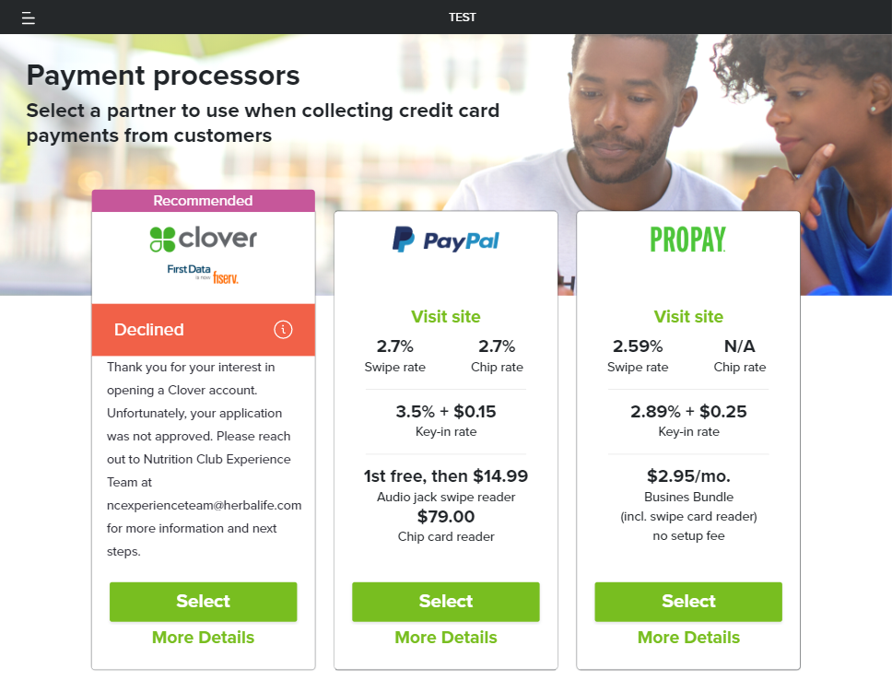
Clover – Account Not Approved
If by any chance your Clover account is not approved by Clover, you will see a “Declined” message and you will receive a letter in the mail with more detail
If you have any questions about your application please contact Clover at 877-273-8191

Slide 14
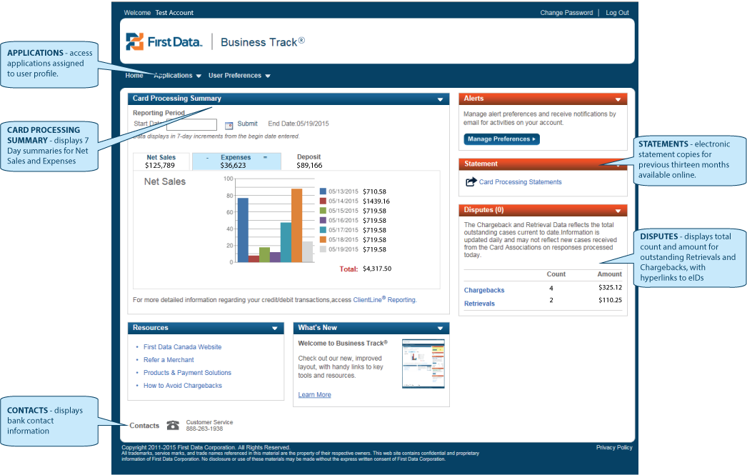
ClientLine
After having signed up for Clover you will also be receiving an email from ClientLine, which is a system that will allow you to review your transactions statement and their related fees
This email will contain your ClientLine ID and a link to create your login
You will be required to answer the “Secret Question” before creating your own login, which is:
Secret Question: What is your favorite holiday?
Answer: Thanksgiving
ClientLine emails are expected to begin on April 1st, 2020.

Slide 15
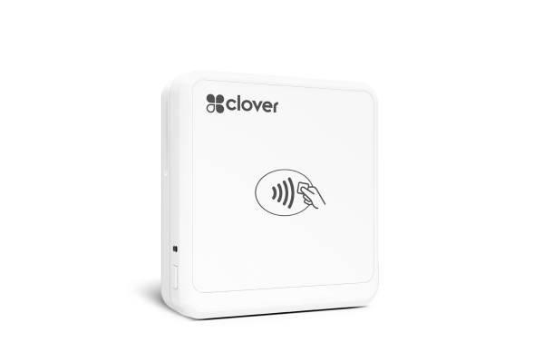
Charge the Clover Go Card Reader
To charge your Clover Go Device:
Plug the included micro USB cable into a phone charger and the other end of the USB cable into the charging port on the Clover Go.
Plug the phone charger into an electrical outlet.
Wait for the blue status light on the Clover Go to turn on.
If setting up for the first time, charge the Clover Go until its battery light turns solid red (fully charged). This will take 1–2 hours. A fully charged battery can last for up to 160 transactions.

Slide 16
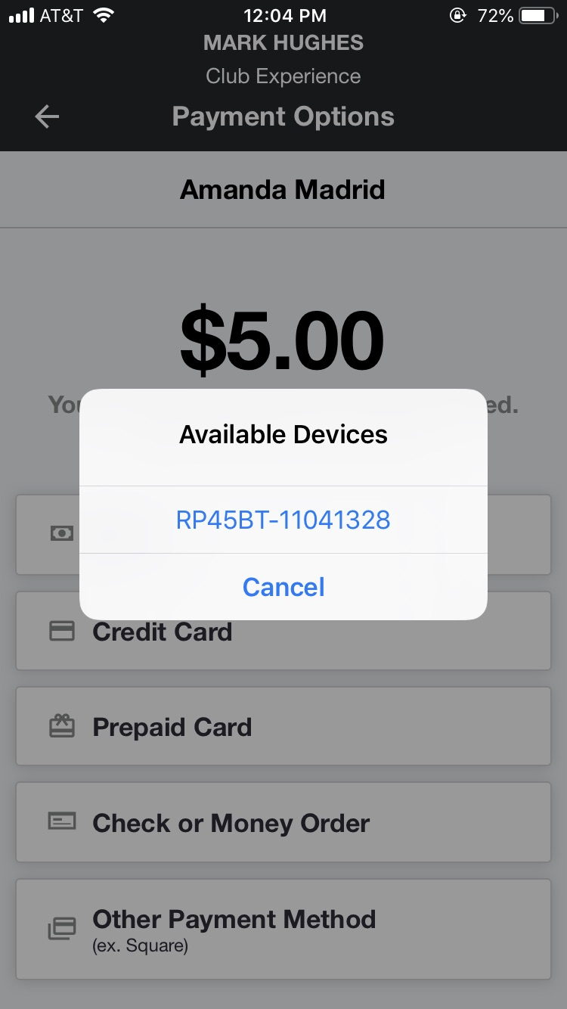
Connect Clover Go to HN MyClub
To connect Clover Go to HN MyClub:
Make sure you are on the most updated version of HN MyClub before you begin pairing your card reader
Make sure Bluetooth is enabled in your Phone or Tablet Settings app (Do not pair the reader from the Settings app. Please follow the steps below to pair it from HN MyClub.)
Make sure the Clover Go is powered on. The blue status light will blink if on. If the Clover Go is not on, hold the power button for 5 seconds until you see the blue light.
To accept a credit card payment, follow the usual steps to document a sale and then select “Credit Card” as the payment method, you will be prompted to select the reader.
Swipe/Insert/Tap the credit card.
We recommend that you try a transaction yourself before you use it with customers at the Club.
For troubleshooting please go to the next slide

Slide 17
Clover Go Pairing Troubleshooting
If you are having trouble pairing your Clover Go reader please try these steps:
Delete the app and redownload.
If you are trying to connect the reader directly through Bluetooth settings, please stop and connect directly through HN MyClub.
Make sure any other processors’ card readers in the vicinity are turned off and disconnected from your device.
Force close the Clover Go app if you have downloaded it.
If you have the reader plugged into a laptop or other device, please plug it into a wall charger directly.
© 2020 Herbalife Nutrition. All rights reserved. USA. NCX1693355-USEN-00 03/20

